Slide 1
Identifying Fake Twitter Accounts with the Same Username via Profile Picture Comparisons
By: Ben Petroski

Slide 2
Summary
Motivation
Approach
Results
Conclusion

Slide 3
Motivation
Twitter is a social media platform that provides users with a method of interacting and acquiring information
Fake accounts can be an annoyance and may convey information that is inaccurate or unnecessary
Estimated that about 1 in 10 Twitter accounts is fake, which equates to 20 million accounts

Slide 4
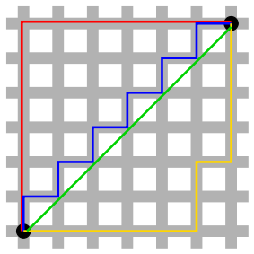
Approach
Performed query to find profiles with identical usernames
Acquired URLs for profile pictures
Imported images into a Python script
Calculated the Manhattan Norm
If Manhattan Norm < 40, then
images are relatively similar
and thus added to list

Slide 5
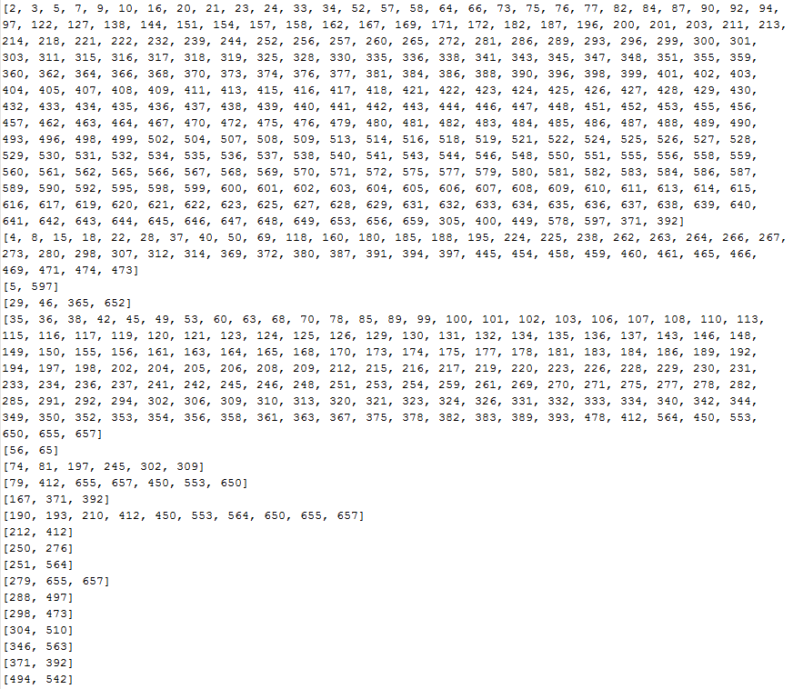



Results
300
49
153

Slide 6
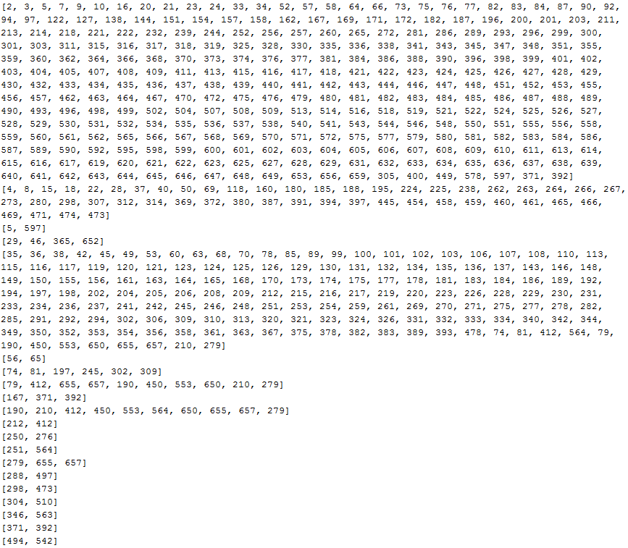
Results
301
49
156

Slide 7
Conclusion
42 duplicates in list, 525 unique matched files
Manhattan Norm is more than capable of being used to identify similar images
Similar profile images are likely to depict profiles that are duplicates
Improve matching for similar images with Manhattan Norm > 40`
Maybe to improve computation, port it to GPUs – would need to use PyCUDA

Slide 8
The End
Thank you to Supraja Gurajala and Professor Matthews for their help with this project
http://stackoverflow.com/questions/189943/how-can-i-quantify-difference-between-two-images
http://stackoverflow.com/questions/23931/algorithm-to-compare-two-images
http://stackoverflow.com/questions/75891/algorithm-for-finding-similar-images

